Slide 1
PIVOT POINT PARTNERS HR ANALYTICS PROJECT
FOCUS ON EMPLOYEE ATTRITION
BY DAVID-PRAISE EBIRINGA

Slide 2

Agenda
Introduction
Problem Statement
Process Workflow
Unclean Data
Cleaned Data
Analysis & Insights
Visualization
Final tips & takeaways

Slide 3
INTRODUCTION
This Power BI project analyzes employee attrition-related characteristics from HR data retrieved internally at Pivot Point Partners, a mid-size consulting firm. The goal is to understand the firm’s overall employee demographics, uncover trends associated with high employee turnover, and provide recommendations on how the firm can retain its employees.

Slide 4
PROBLEM STATEMENT
Employee attrition poses a significant challenge for organizations, thus leading to increased recruitment costs, disruptions in workflow, and loss of institutional knowledge.
Factors contributing to employee attrition include burnout, lack of career development opportunities, etc.
Lately, Pivot Point Partners has been experiencing a high turnover rate and has decided to delve into this issue to understand why this is happening.

Slide 5
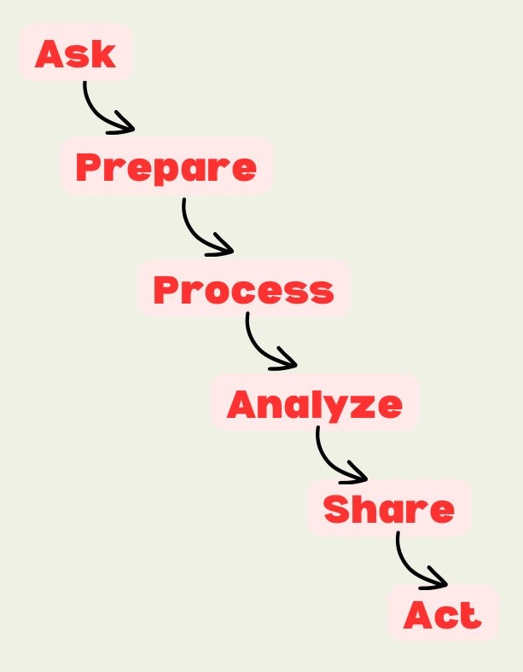
Process workflow
The Ask and Prepare steps are not relevant to this project

Slide 6
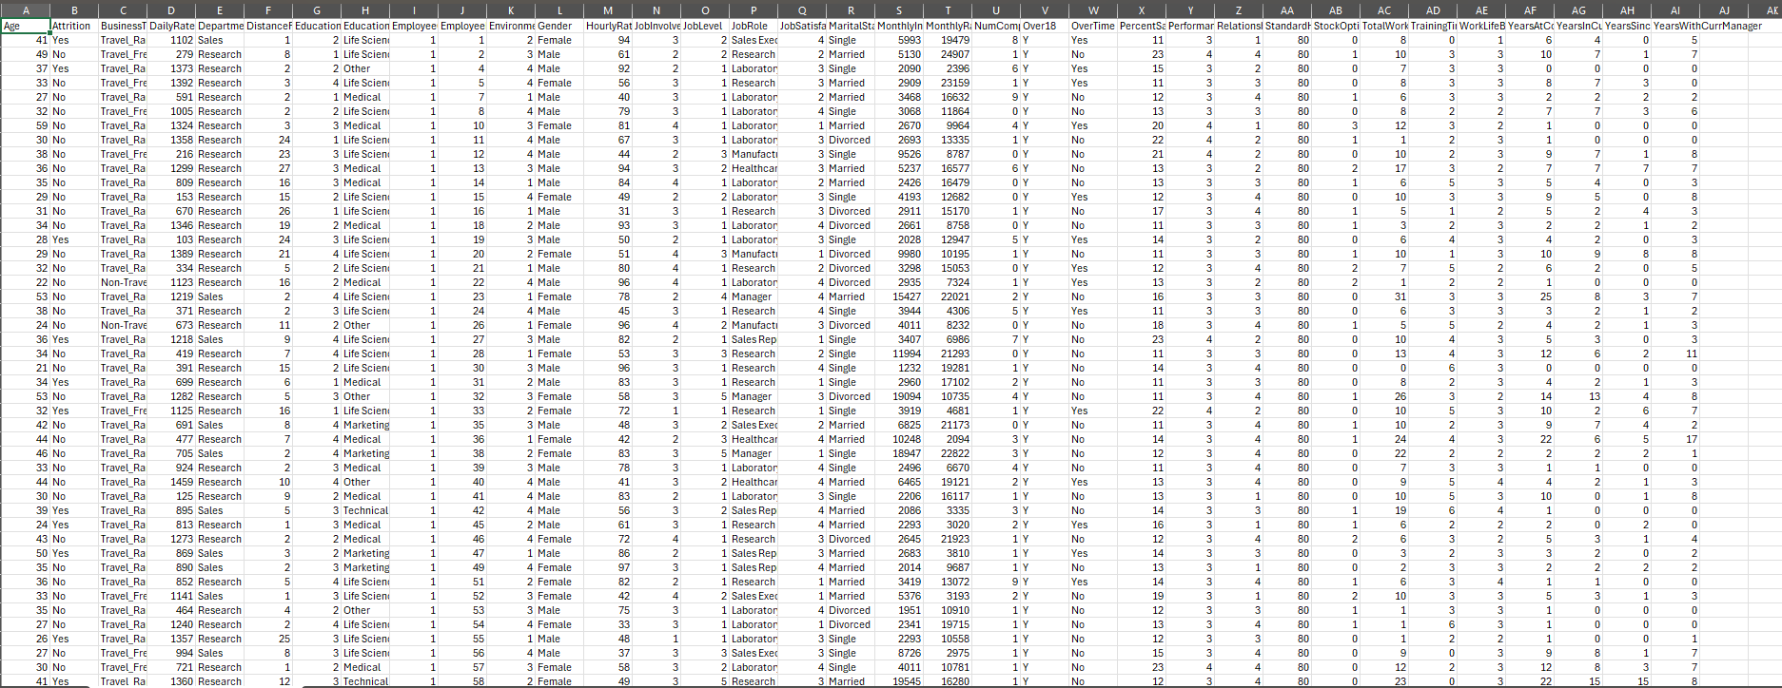
UNCLEAN DATA

Slide 7
Data transformation process

Slide 8
DATA CLEANING PROCESS
Renamed the “Distance From Home” column to reflect “Distance From Home (Km) (groups)”
Created a new column, “education – copy” using switch() to reclassify education level to reflect:
1 – No Education
2 – Secondary Education
3- Some college/ Associate Degree
4 – Bachelor’s Degree
5 – Advanced Degree
Removed the following columns: “Job Involvement”, “Employee count”, and “Environment satisfaction.”
Re-classified the “Job Satisfaction” column using replace values to now reflect:
1 – Very dissatisfied
2 – Dissatisfied
3 – Satisfied
4 – Very satisfied
Performed similar re-classifications for “Job Level”, “Work Life Balance”, and “Relationship Satisfaction” columns.

Slide 9
DATA CLEANING PROCESS
Created new measures “Male_count” and “Female_count” using Count AX().
Created a new column, “Age Group” using switch().
Created new measures, “Male_Attrition” and “Female_Attrition” using CountRows().
Created a new calculated column: “Income Lvl.”
Created a new calculated column: “Tenure_Lvl.”
Created a new calculated column: “Role_Tenure_Lvl” to reflect:
0-2 (years) – New to Role
3-5 – Early Stage in Role
6-10 – Mid Stage in Role
11-15 – Experienced in Role
> 15 = Veteran in Role

Slide 10
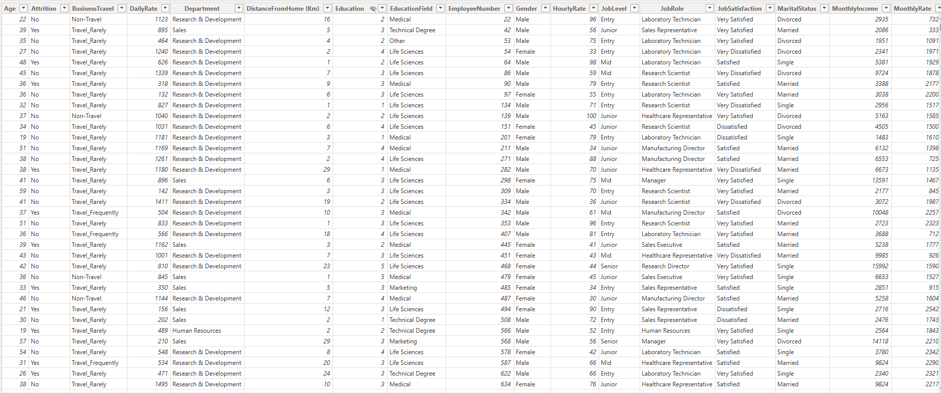
CLEANED DATA (Part 1)

Slide 11
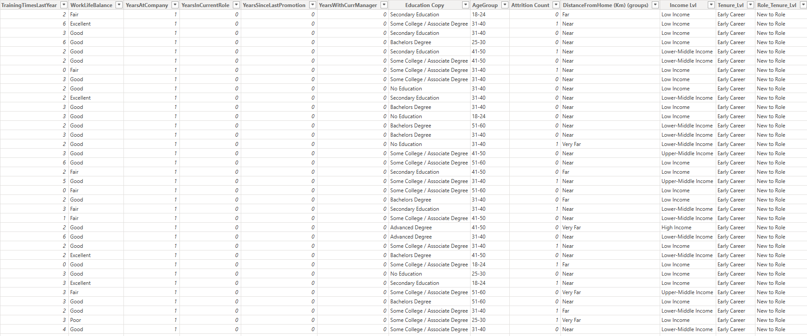
CLEANED DATA (Part 2)

Slide 12
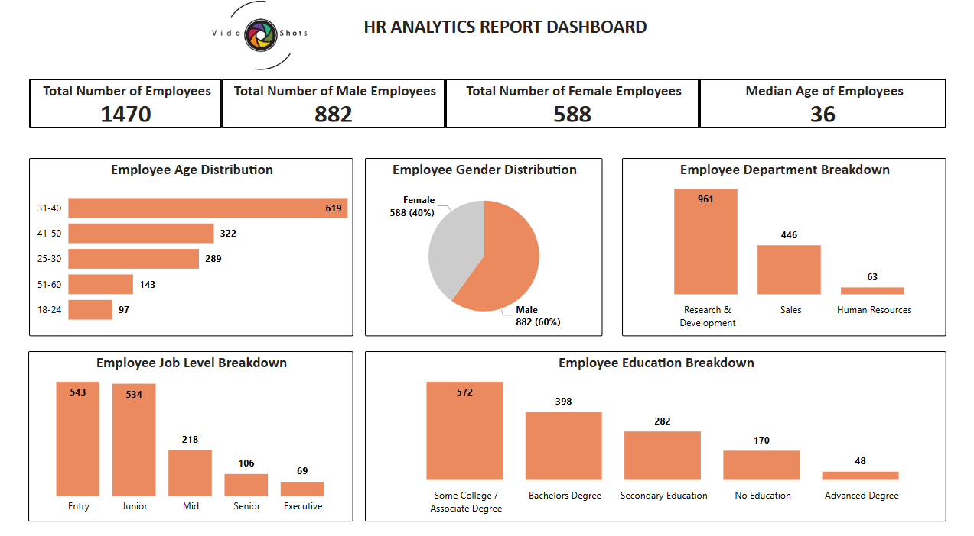

Analysis & Insights (Employee Demographics)

Slide 13
VISUALIZATION

Slide 14
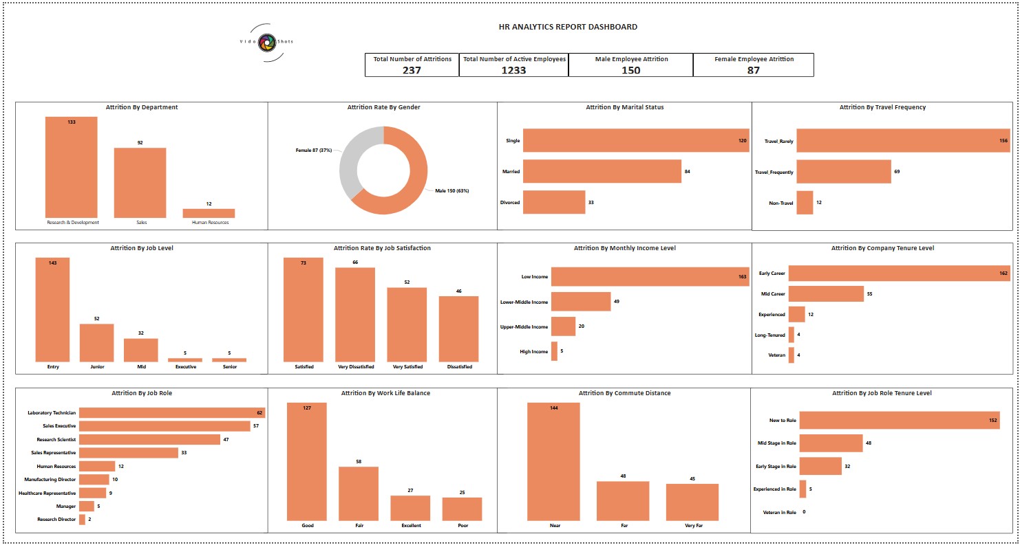

Slide 15
TURNOVER ANALYSIS

Slide 16
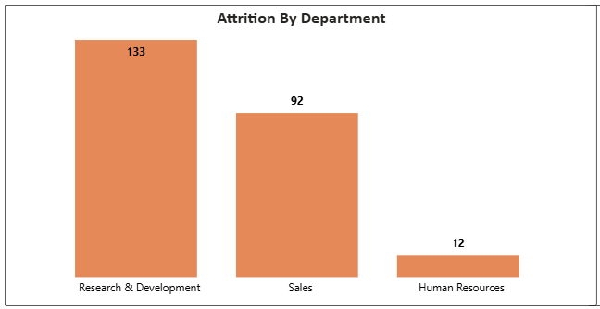
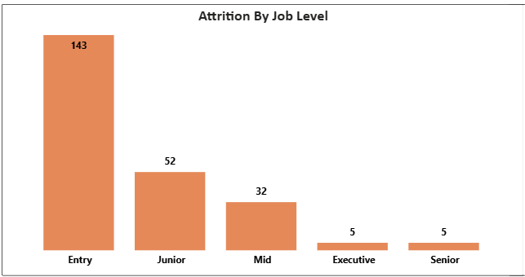
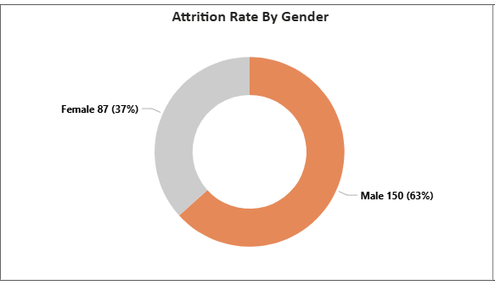
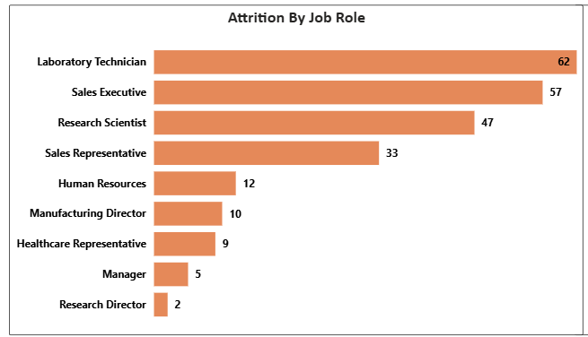
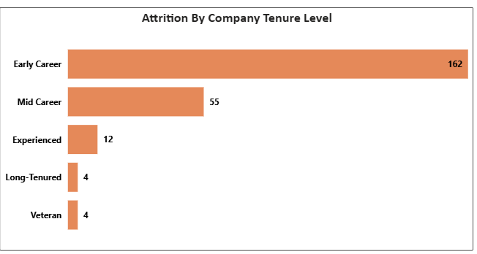
The R&D department had the highest turnover count compared to other departments
Most of the employees that left were laboratory technicians
Most employees that left were staffed in entry-level positions or were at the early career level

Slide 17
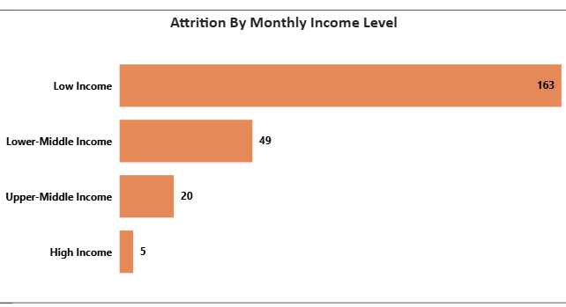
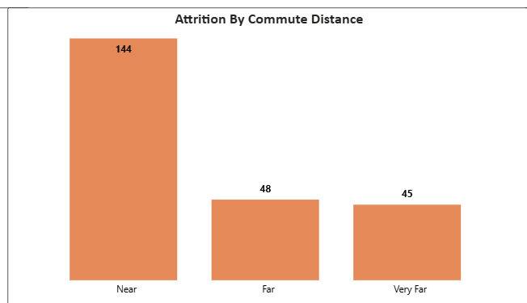
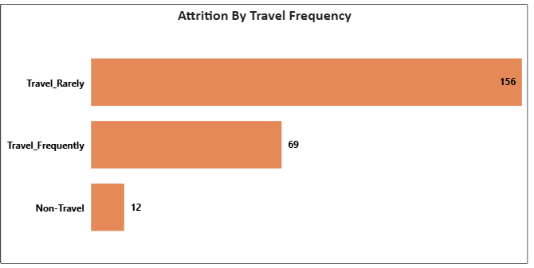
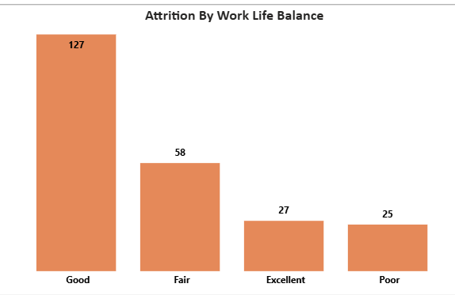
Employees on a low monthly income level were mostly the ones to leave the firm
Neither commute distance nor travel frequency were factors contributing to high employee attrition as one would expect.
Even employees with a decent work life balance still chose to leave. Perhaps for greener pastures elsewhere or due to other factors.

Slide 18
Final tips & takeaways
To improve employee attrition, I recommend implementing these strategies:
Create a solid onboarding process that ensures new hires feel adequately supported and integrated into the organizational culture from day one.
Conduct exit interviews to identify trends and act on prominent issues that force employees to leave.
Review salaries regularly and offer benefits that align with employee needs, such as healthcare, retirement plans, paid leave, etc.
Provide training, mentorship, and a clear pathway for advancement to convince employees (especially those at the early career stage) that their professional growth is a priority.
Finally, invest in enhancing employee engagement via recognition programs, team-building activities, and regular feedback from management/senior employees.
Consistent rehearsal
Strengthen your familiarity
Refine delivery style
Pacing, tone, and emphasis
Timing and transitions
Aim for seamless, professional delivery
Practice audience
Enlist colleagues to listen & provide feedback

Slide 19

THANK YOU
David-Praise Ebiringa, MPH, MSM
LinkedIn: Click Here

